Slide 1
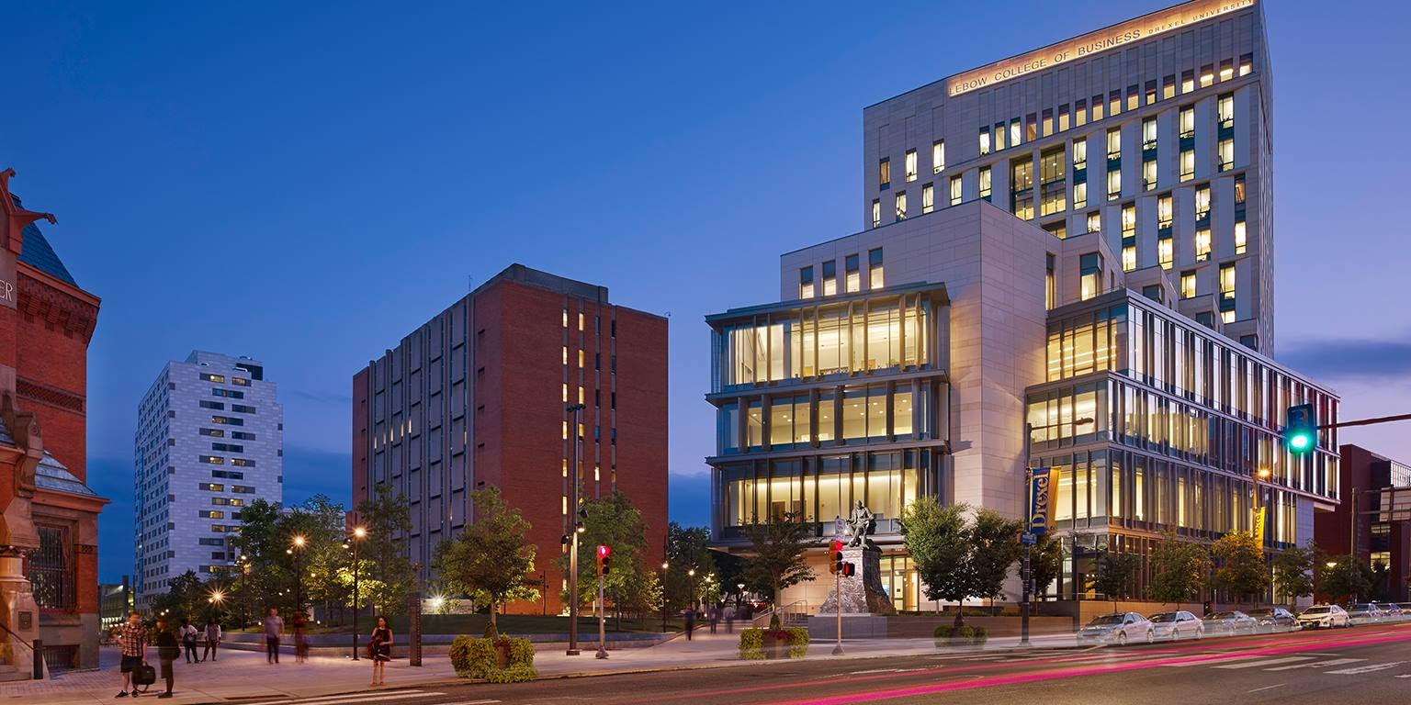
FORECASTING DREXEL’s Research Awards and Expenditures
Consulting Project
Jingyi Li
Zijing Liu
Jonathan Roselli
Ao (Sophia) Tan
Apurva Tawde
Zinan Yang
Yushan Cai
Changpeng Cheng Yagna Ganesh
Ryan Ferguson
Yuguan Liu
Tu Trinh Nguyen
Junwei Wang
Parag Paliwal
Siddharth Chaudhary
Vinod Balraj
Xin Huo
Yi Jin

Slide 2

Business Challenge
To develop forecasting models for research awards and annual expenditures for the Office of Research.
What is the 5-year research funding
and expenditure outlook for the University?
What is our ‘hit’ rate?

Slide 3
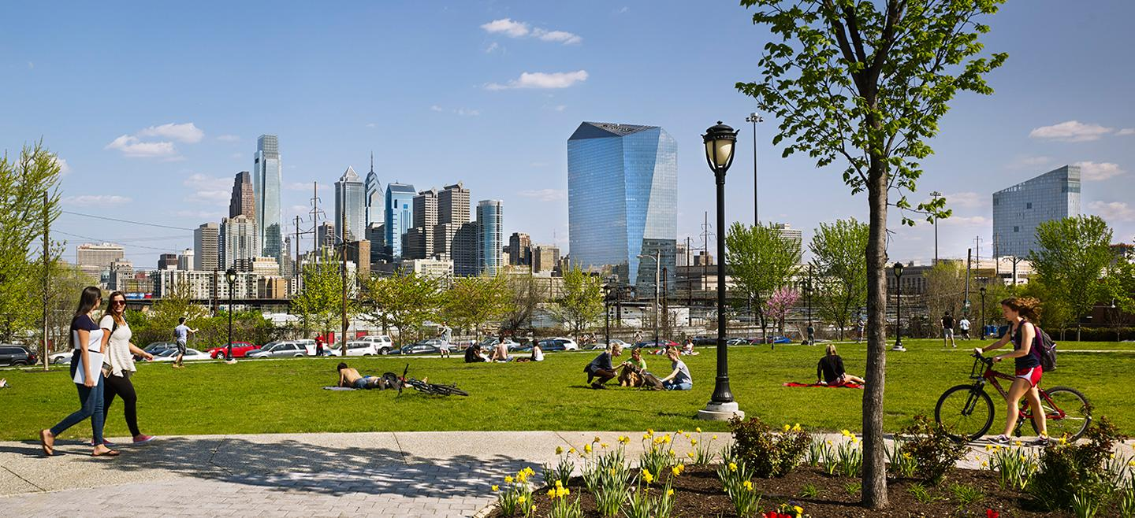
Project Timeline
Project Start - Milestone 2
Milestone 4-5
PLAN: Identify problem, determine scope, create project plan, perform due diligence, do data summary, establish proposal and approach
ANALYZE: Hit rate calculation, sample selection, forecasting model
Project Start
Sep 25
Milestone 2
Oct 16
Milestone 4
Oct 29
Milestone 6
Nov 12
Client Presentation
Dec 6
Sep
Nov
Milestone 1
Oct 9
Oct
Milestone 5
Nov 5
Milestone 7
Nov 29
Milestone 3
Oct 22
Milestone 3
EXECUTE: Cleanse dataset, Set hypothesis, demo proposed approach, mock-up out model
Milestone 7
ANALYZE & REVIEW: Analyze data findings and interpret results, articulation of business insights and recommendations, final deliverables

Slide 4
Industry Analysis
SOURCE:
National Science Foundation, Higher Education Research and Development Survey
The Center for Measuring University Performance at the University of Massachusetts Amherst and the University of Florida, The Top American Research Universities annual report 2016, 2017

Slide 5
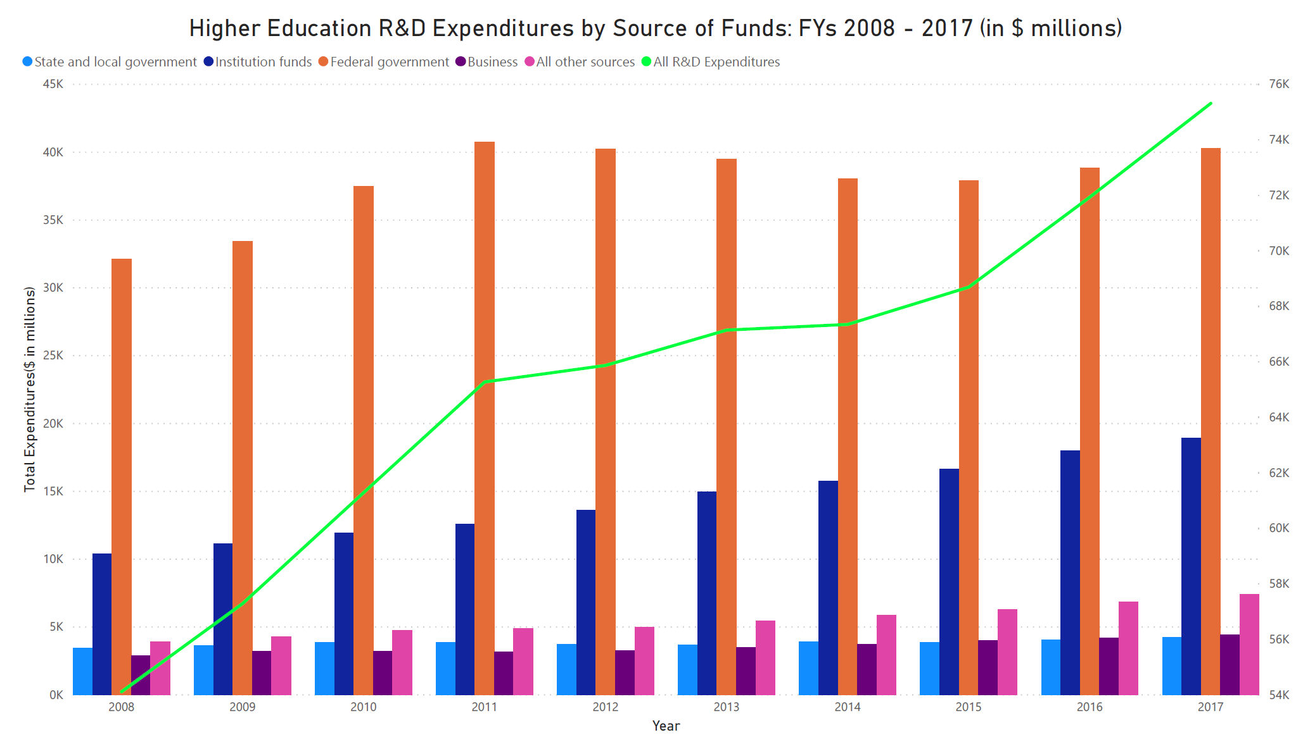
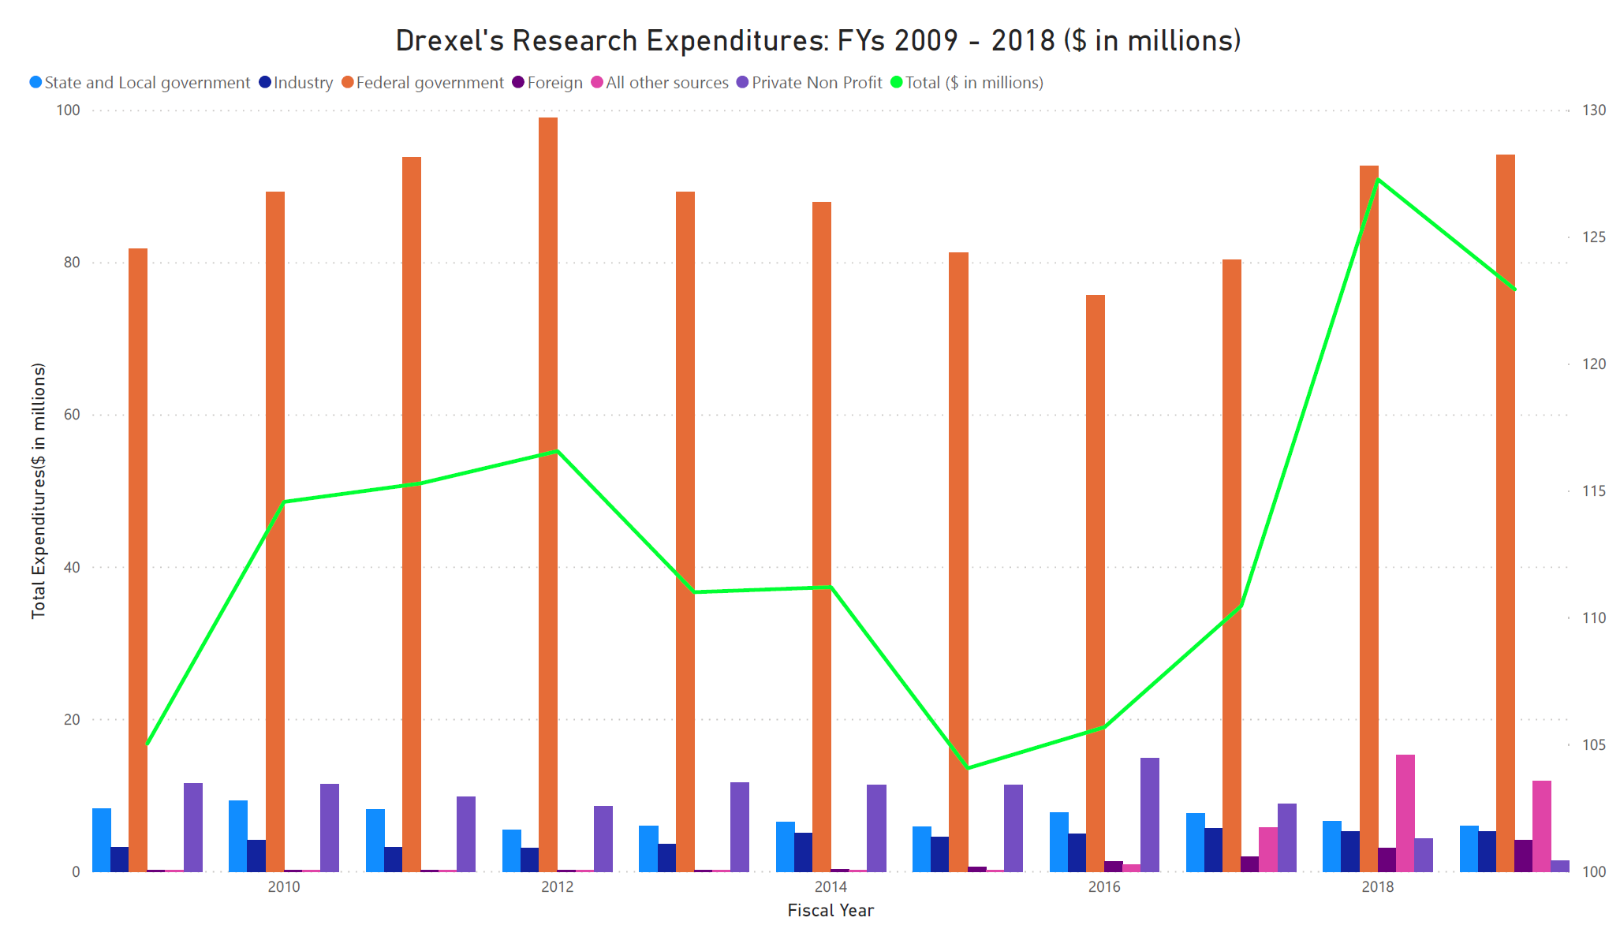
Trends by Source of Funding
The national average annual growth rate is about 4%, and there is a consistent and slow growth after 2011. Drexel’s average annual growth rate is about 1.6%, and it has a decreased trend from 2013 to 2015.The total amount of funding has been slowly increasing after 2015.
The reliance on federal funding for university R&D is declining and reaches the lowest on record by 2015. This decline is not due to reduced funding, but rather the result of the expansion of nonfederal funding sources.
*Bar chart metric (expenditure by source of funding) refers to left axis
Line chart metric (expenditure by total amount) refers to right axis

Slide 6
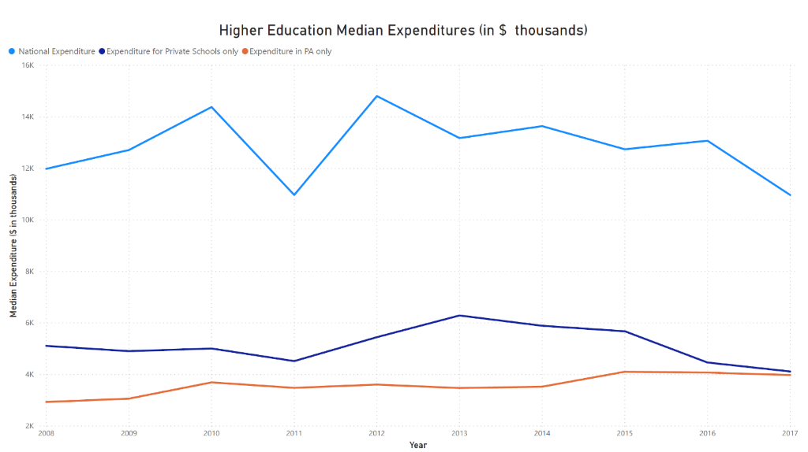
Trends by Median Expenditure (FYs 2008 - 2017)
The median dollar amount has been inconsistent with a sharp dip in 2011.
The private research universities over this decade follows the same pattern trend as observed
Institutions showed a steady slowly increase after 2009 keeping at 3 billion in total each year. Pennsylvania private schools has an average growth rate of 5% that exceeded the national average annual growth rate of 4%.
2011
As the top largest research universities continued to receive the funding at an increased rate, a large percentage of the schools that are on the bottom of list struggled to split a share of funding in that year.

Slide 7
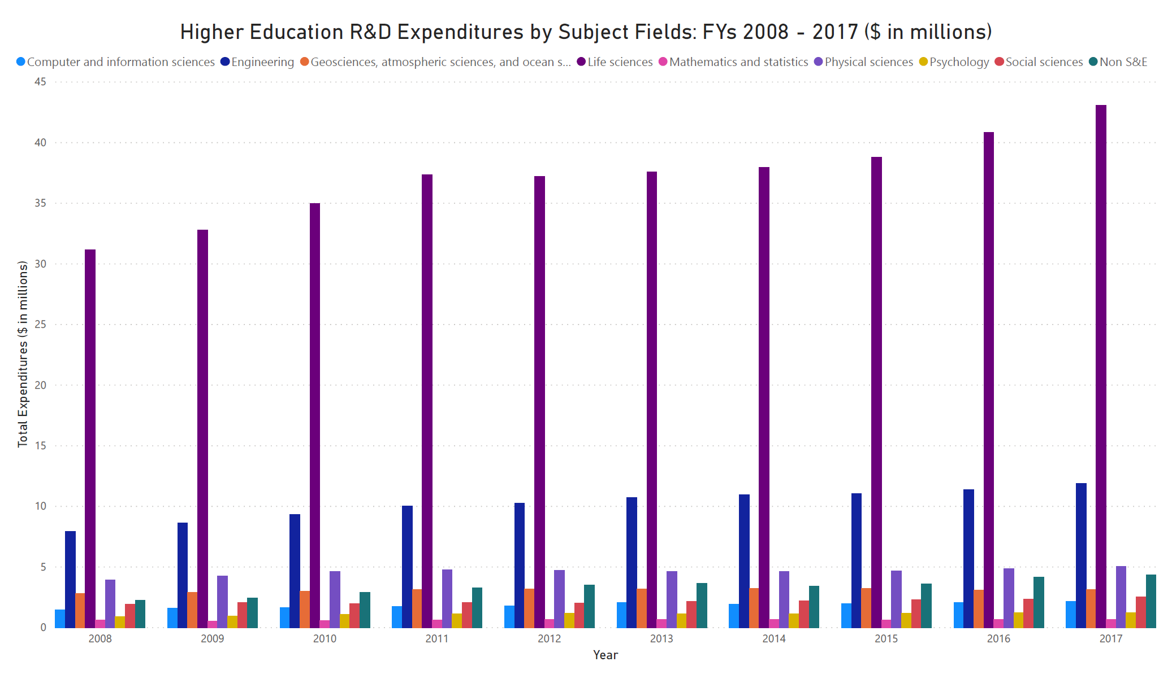
Trends by Subject Field
Nationwide average annual total spending by subject field:
Science: 80% (including Life science 57%)
Engineering: 16%
Nationwide annual growth rate by subject field:
Non-science and engineering: 8%
Computer and information sciences: 5%
Engineering: 5%, Life science: 4%
Research at top government-funded universities is heavily concentrated in Life Sciences and Engineering fields. Within these fields, medicine is nearly always the largest recipient of research funds with federal research grants

Slide 8
Data Overview

Slide 9
Proposal & Awards

Slide 10
Proposals Summary
Overall, the total number of proposals submitted over the years is decreasing.
Notes:
Note:
Filter for proposals: New and Resubmission
Counted distinct proposal numbers each year

Slide 11
Awards Summary

Slide 12
Proposal Amount Summary
Notes:
Note:
Filter for proposals: New and Resubmission
Sum of total proposal amount ( not obligated amount)

Slide 13
Award Amount Summary
Notes:
Note: Proposal Type: New & resubmissions
sum of obligated amounts for each fiscal year

Slide 14
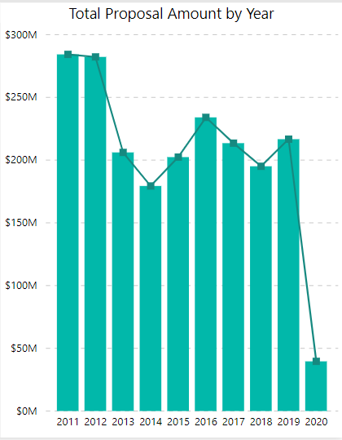
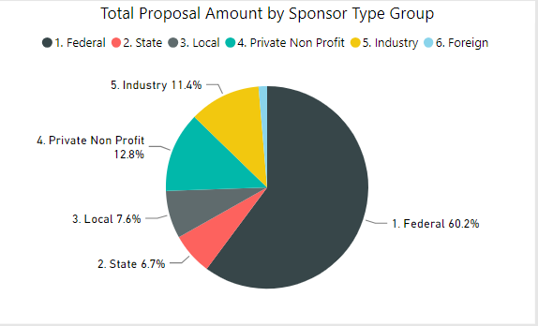
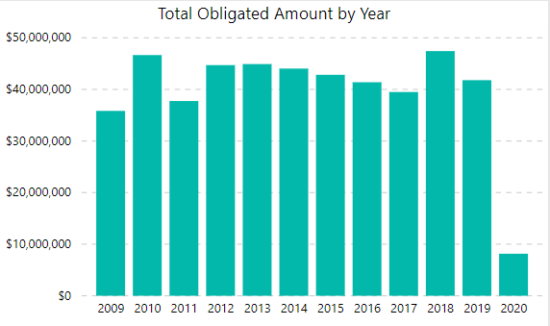
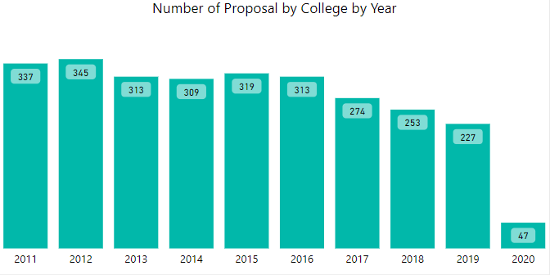
Data Summary: Proposal & Award Data Set – College of Medicine
Notes:
PowerBI updated link (11/3): https://app.powerbi.com/view?r=eyJrIjoiNjc1NmEzYTMtN2NmNi00NGRmLWFiNTMtOTI1NzEwMTZlYzFkIiwidCI6IjBhNzg0MTQ2LTU4MTYtNDhjMi1iODk5LWY0NTRiMzI5NDFhZSIsImMiOjF9
Among all the proposal submitted, College of Medicine, College of Engineering, and College of Art and Science take the most percentage, with 28%, 23%, and 12% respectively.
Thus, let’s take a close look at one of the major colleges, College of Engineering, as an example.

Slide 15
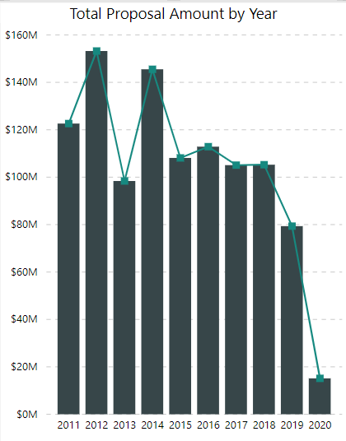
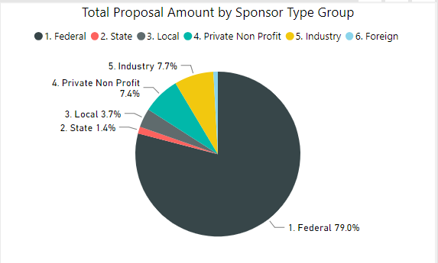
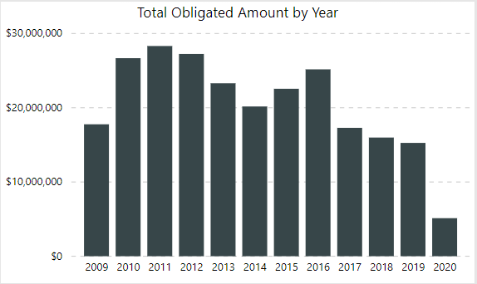
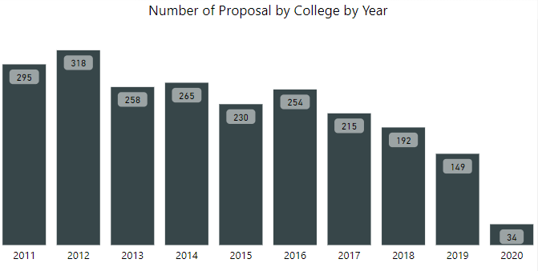
Data Summary: Proposal & Award Data Set – College of Engineering
Notes:
PowerBI updated link (11/3): https://app.powerbi.com/view?r=eyJrIjoiNjc1NmEzYTMtN2NmNi00NGRmLWFiNTMtOTI1NzEwMTZlYzFkIiwidCI6IjBhNzg0MTQ2LTU4MTYtNDhjMi1iODk5LWY0NTRiMzI5NDFhZSIsImMiOjF9
Among all the proposal submitted, College of Medicine, College of Engineering, and College of Art and Science take the most percentage, with 28%, 23%, and 12% respectively.
Thus, let’s take a close look at one of the major colleges, College of Engineering, as an example.

Slide 16
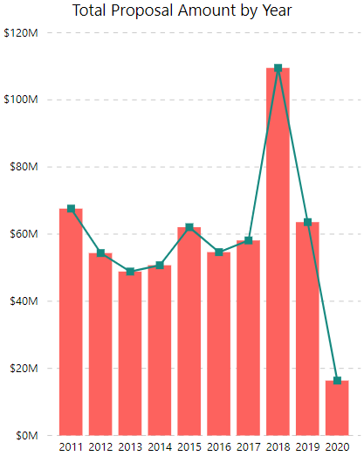
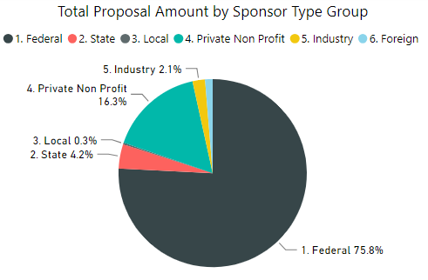
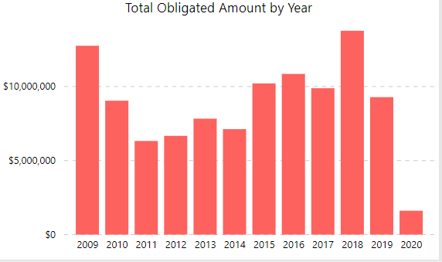
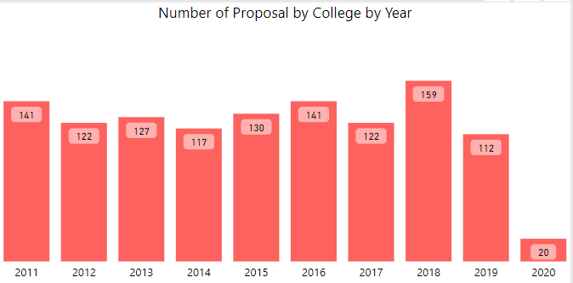
Data Summary: Proposal & Award Data Set – College Art and Science
Notes:
PowerBI updated link (11/3): https://app.powerbi.com/view?r=eyJrIjoiNjc1NmEzYTMtN2NmNi00NGRmLWFiNTMtOTI1NzEwMTZlYzFkIiwidCI6IjBhNzg0MTQ2LTU4MTYtNDhjMi1iODk5LWY0NTRiMzI5NDFhZSIsImMiOjF9
Among all the proposal submitted, College of Medicine, College of Engineering, and College of Art and Science take the most percentage, with 28%, 23%, and 12% respectively.
Thus, let’s take a close look at one of the major colleges, College of Engineering, as an example.

Slide 17
Expenditures

Slide 18
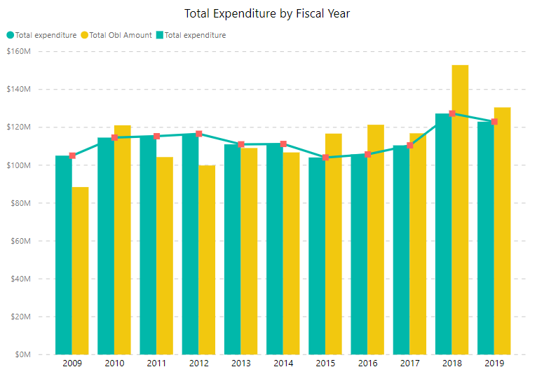
Expenditure Data Summary
Total Expenditure as well as Total Obligated amount increased in recent fiscal years.
In year of 2018, a peak occurred with total expenditure of $127 million and total obligated amount of $153 million
Notes:
PowerBI updated link (11/3): https://app.powerbi.com/view?r=eyJrIjoiNjc1NmEzYTMtN2NmNi00NGRmLWFiNTMtOTI1NzEwMTZlYzFkIiwidCI6IjBhNzg0MTQ2LTU4MTYtNDhjMi1iODk5LWY0NTRiMzI5NDFhZSIsImMiOjF9
According to the data, in years between 2009 and 2019, the top 3 colleges that have the majority of research expenditures are College of Medicine, College of Engineering, and College of Art and Science with a 38%, 19% and 9% of total research expenditures respectively.
Thus, let’s take a close look at one of the major colleges, College of Engineering, as an example.

Slide 19
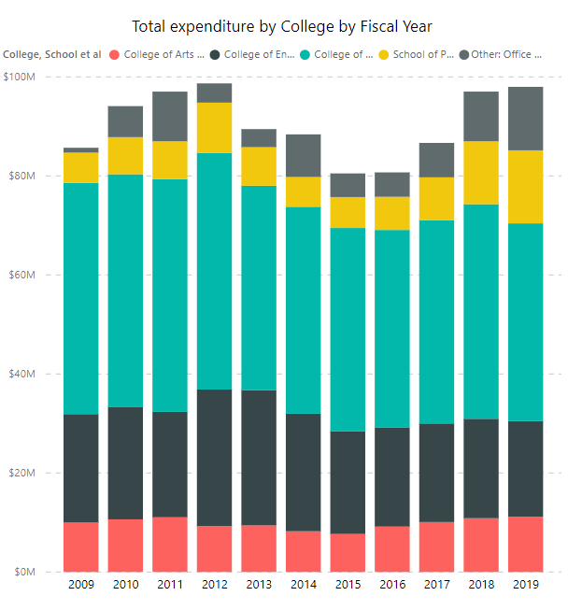
Expenditure Data Summary
The graph shows the top five colleges by total expenditure.
College of Medicine has the most expenditures over the years.
Other Offices
School of Public Health
College of Medicine
College of Engineering
College of Art and Science
Notes:
PowerBI updated link (11/3): https://app.powerbi.com/view?r=eyJrIjoiNjc1NmEzYTMtN2NmNi00NGRmLWFiNTMtOTI1NzEwMTZlYzFkIiwidCI6IjBhNzg0MTQ2LTU4MTYtNDhjMi1iODk5LWY0NTRiMzI5NDFhZSIsImMiOjF9
According to the data, in years between 2009 and 2019, the top 3 colleges that have the majority of research expenditures are College of Medicine, College of Engineering, and College of Art and Science with a 38%, 19% and 9% of total research expenditures respectively.
Thus, let’s take a close look at one of the major colleges, College of Engineering, as an example.

Slide 20
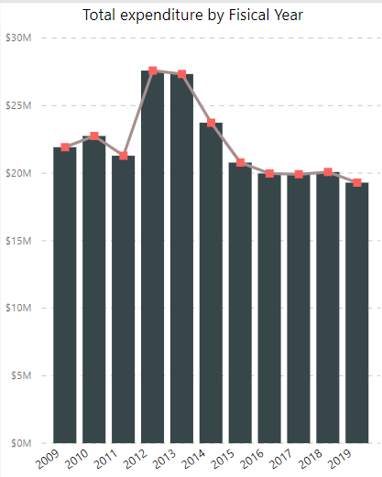
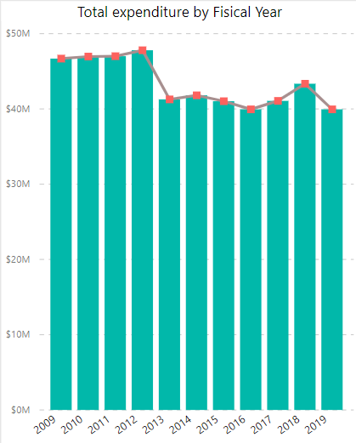
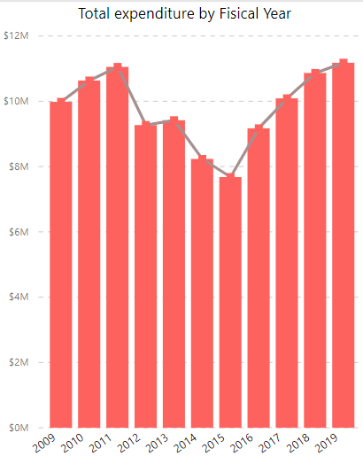
Expenditure Data Summary
College of Engineering
College of Medicine
College of Art and Science
Notes:
PowerBI updated link (11/3): https://app.powerbi.com/view?r=eyJrIjoiNjc1NmEzYTMtN2NmNi00NGRmLWFiNTMtOTI1NzEwMTZlYzFkIiwidCI6IjBhNzg0MTQ2LTU4MTYtNDhjMi1iODk5LWY0NTRiMzI5NDFhZSIsImMiOjF9
According to the data, in years between 2009 and 2019, the top 3 colleges that have the majority of research expenditures are College of Medicine, College of Engineering, and College of Art and Science with a 38%, 19% and 9% of total research expenditures respectively.
Thus, let’s take a close look at one of the major colleges, College of Engineering, as an example.

Slide 21
Sponsors

Slide 22
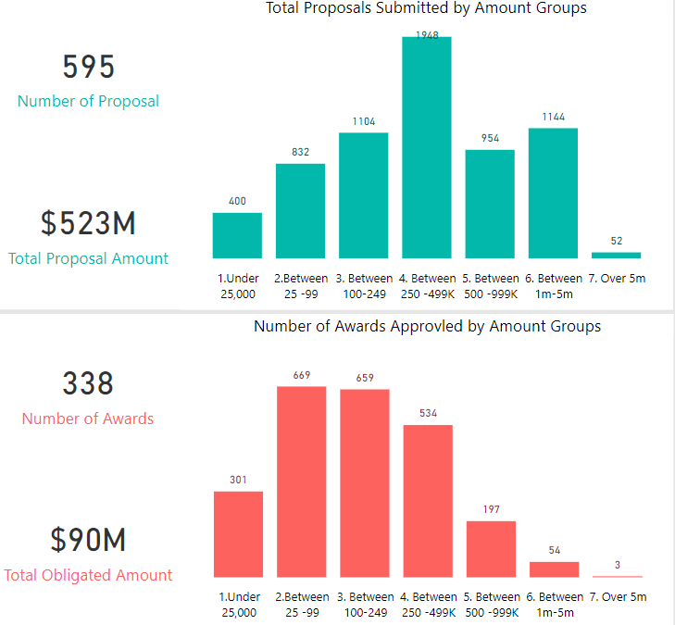
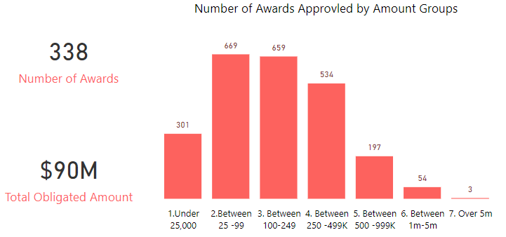
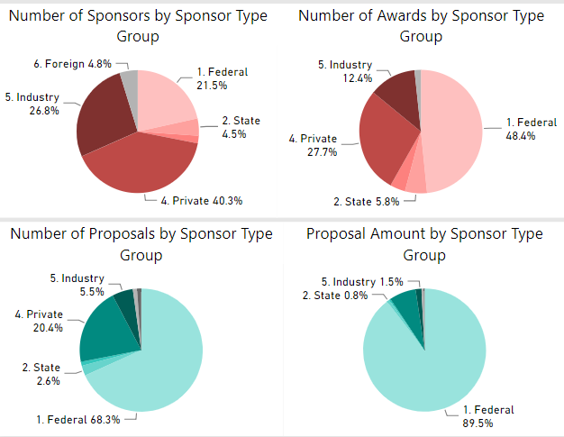
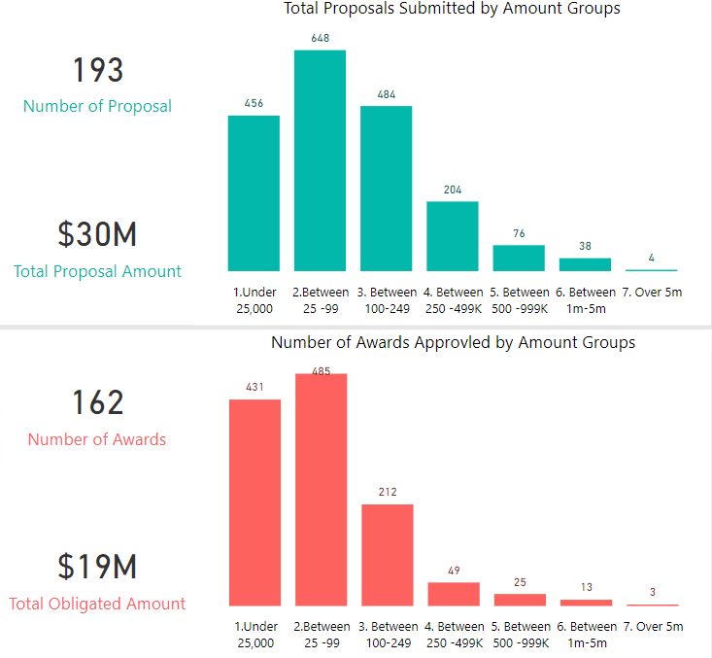
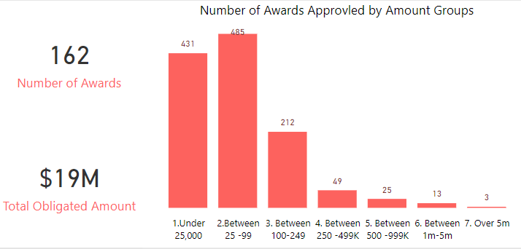
Data Summary – Sponsor Type
Federal Sponsors
Private Sponsors
For the Amount Group, there are about 58% proposal submitted between 100K to 1 Million
About 35% of them got approved
For the Amount Group, there are about 34% proposal submitted less than 100K
About 76% of them got approved
Notes:
PowerBI updated link (11/3): https://app.powerbi.com/groups/me/reports/cf431fa7-b192-4819-b6e3-0a3ec8e8056f/ReportSection25c15821c55c8872b897
One of the examples for Federal sponsorship is College of Engineering, with 971 Federal agencies sponsored over the 10 year period. However, not all colleges are sponsored by Federal. For instance, from year 2009 to year 2019, College of Media Art and Design have the most sponsorships from private agencies, with a number of 40 private agencies.

Slide 23
Data Cleaning

Slide 24
Expenditure Dataset and Awards Dataset
Expenditure Data Set (123,650 observations with 48 variables)
We dropped variables “Frbgrnt Grnt Code Related” , “2 digit cfda” & “Spriden Last Name2”.
For “PT Agency”, “ID”, “Frvcfda Title”, we replaced the <NA> values with the “NA” Strings as they can be considered as NA level in analysis.
Similarly, numeric variables such as “Frragpt Federal Fund Percent”, “Frragpt Agcy Pidm”, “Frvcfda Cfda Code” were substituted to 0 instead of <NA>.
Finally, all the rows with missing values were removed and now the cleaned Expenditure has 108,430 observations with 43 variables.
Award Data Set (7,392 observations with 54 variables)
We dropped columns with over 50% missing values.
The cleaned Award has 7,392 observations with 48 variables.
Notes:
Appendix II – Data Cleaning

Slide 25
Merged Data for Proposals and Awards
Proposal & Award Data Set (4,139 observations with 106 variables)
To calculate the hit rate, we joined the proposals & awards datasets by proposal numbers.
While joining, we removed over 3,000 observations from the two datasets and removed 25 duplicated columns.
We removed most columns with over 50% missing values, but kept some columns that are important, such as “Primary Sponsor Name”.
We removed 24 observations because of inconsistency between proposal date and award effective date.
The cleaned Proposal & Award dataset has 4,139 observations with 78 variables.
Notes:
Appendix II – Data Cleaning

Slide 26
Clustering

Slide 27
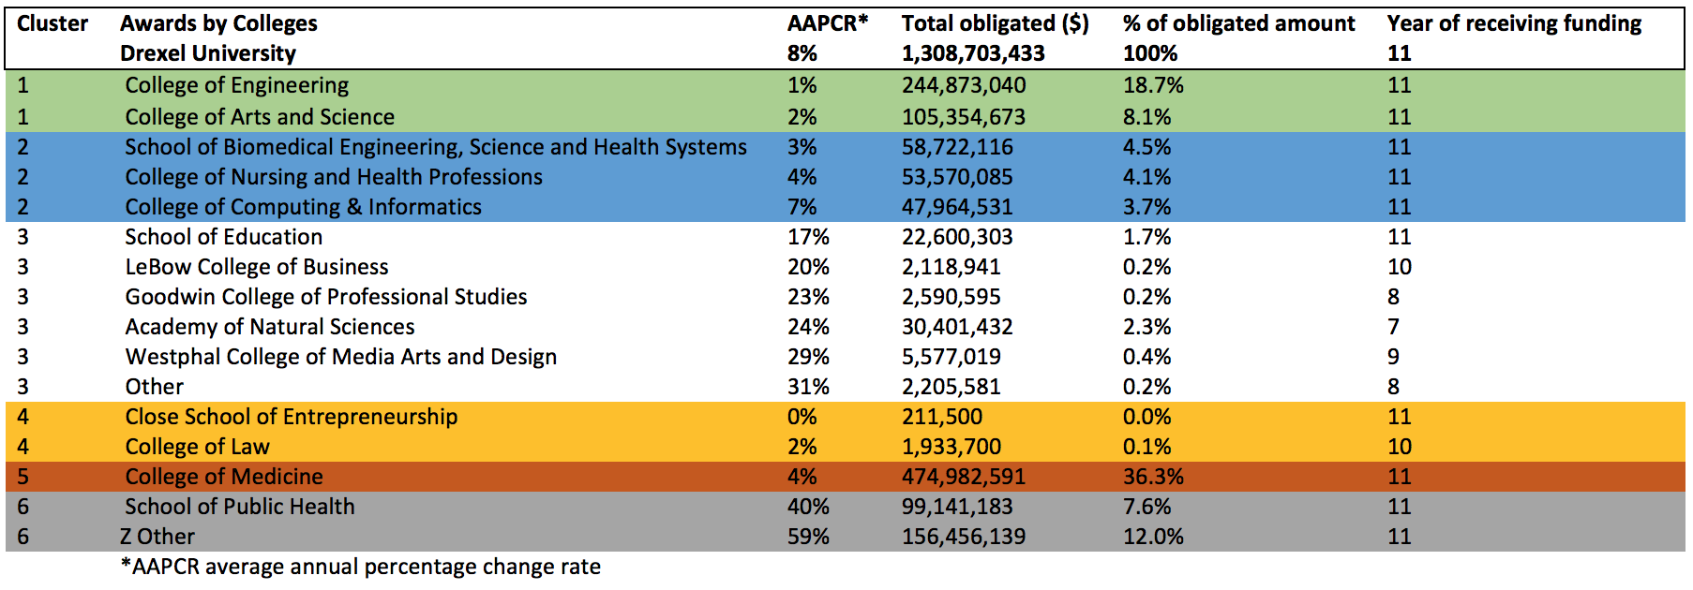
Clustering – Awards by College
Clustering by Trend
Used compound growth factor to find the annual average percentage change rate in awards amount over 12 years
Sorted by absolute value in comparison to % of total awards amount
A similar trend between the two factors within each cluster
Green – Cluster 1
Stable and consistent awards growth rate
Count as second largest % of total awards amount (26.8%)
Blue- Cluster 2
Moderate fluctuation in awards receiving amount
Significant % of total awards amount
White-Cluster 3
Discontinued or missing years
Inconsistent awards pattern
Least % of total awards amount
Yellow (omit)-Cluster 4
A stable awards growth rate but subtle amount due to the lack of record
Red- Cluster 5
Moderate fluctuation in awards receiving amount
Largest % of total awards amount
Grey- Cluster 6
Most fluctuated awards receiving pattern
Large % of total awards amount

Slide 28
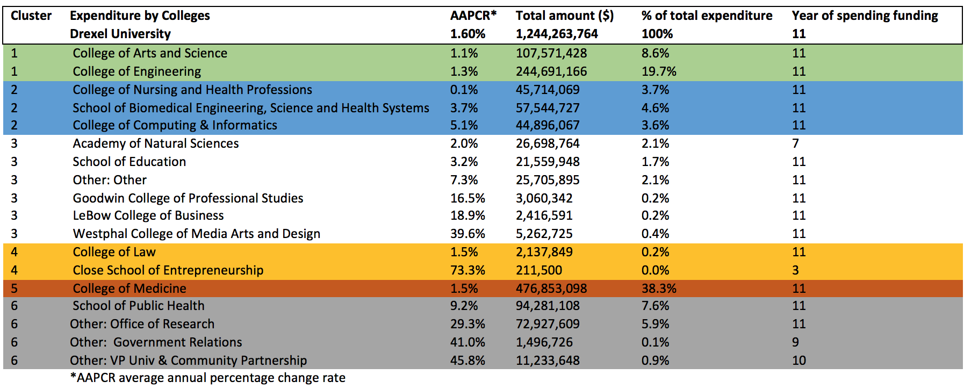
Clustering by Trend
Used compound growth factor to find the annual average percentage change rate in expenditure amount over 11 yrs
Sorted by absolute value in comparison to % of total spending amount
A similar expenditure and awards pattern between each cluster
Green-Cluster 1
Stable and consistent expenditure growth rate
Count as second largest % of total expenditure amount (28.3%)
Blue- Cluster 2
Moderate fluctuation in annual spending
Significant % of total expenditure amount
White –Cluster 3
Discontinued or missing years
Inconsistent expenditure pattern
Least % of total expenditure amount
Yellow (omit)- Cluster 4
A subtle amount due to the lack of record
Red- Cluster 5
Moderate fluctuation in spending amount
Largest % of total expenditure amount
Grey- Cluster 6
Most fluctuated expenditure pattern
Large % of total expenditure amount
*College of Nursing, Natural Science and Education: most consistent expenditure amount besides a fluctuated awards receiving pattern
Clustering – Expenditure by College

Slide 29
Hit Rate

Slide 30
Hit Rate Methodology
Step 1 - Proposal Type: "New", "Resubmission", and "Revision"; Award Type: "New".
Step 2 - Used Fiscal Year in both Proposal and Award datasets.
Year of awards from 2009 to 2020; Year of proposals from 2011 to 2020
Step 3 - Proposal Count: total proposals submitted each year.
Step 4 - If same proposal received multiple awards, we kept the 1st occurrence year and counted as one conversion.
Step 5 - Calculated lag year for each proposal that received an award.
Proposal No. | Awards Year | Awards Quarter
10010901 | 2011 | Q3
10010901 | 2013 | Q3
10010901 | 2014 | Q3
10010901 | 2015 | Q2
Proposal No. | Awards Year | Lag Year | Proposal Year
10102071 | 2011 | 0 | 2011
10102113 | 2015 | 4 | 2011
11012385 | 2013 | 2 | 2011
11012388 | 2012 | 1 | 2011

Slide 31
Hit Rate Methodology
Step 6 - Added up award count by fiscal year along with lag year.
.
Hit Rate (FYs 2011 - 2020)
FY | Award Count | Proposal Count | Hit Rate (%)
2011 | 301 | 1018 | 29.57
2012 | 296 | 1084 | 27.31
2013 | 288 | 1015 | 28.37
2014 | 244 | 1009 | 24.18
2015 | 266 | 1049 | 25.36
2016 | 274 | 1129 | 24.27
2017 | 332 | 1038 | 31.98
2018 | 300 | 1004 | 29.88
2019 | 211 | 856 | 24.65
2020 | 21 | 169 | 12.43
Average |  |  | 25.80
Award Count Example​
Proposal Year | Lag Year | Awards Year | Award Count
2011 | 0 | 2011 | 176
2011 | 1 | 2012 | 98
2011 | 2 | 2013 | 22
2011 | 3 | 2014 | 2
2011 | 4 | 2015 | 3

Slide 32
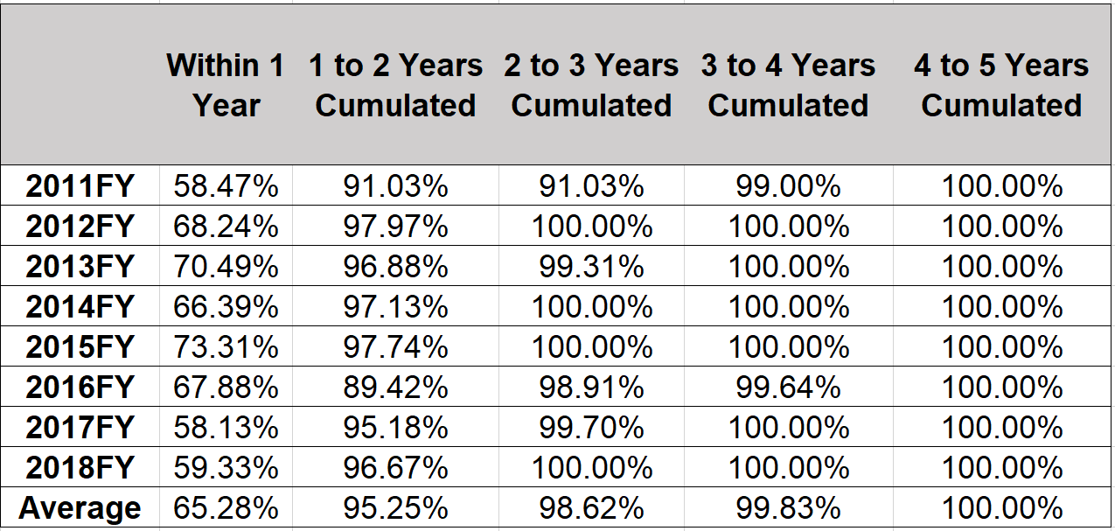
Hit Rate – Lags Between Proposal Submitted and Award Notice Received
Maximum lag is 4 Years.

Slide 33
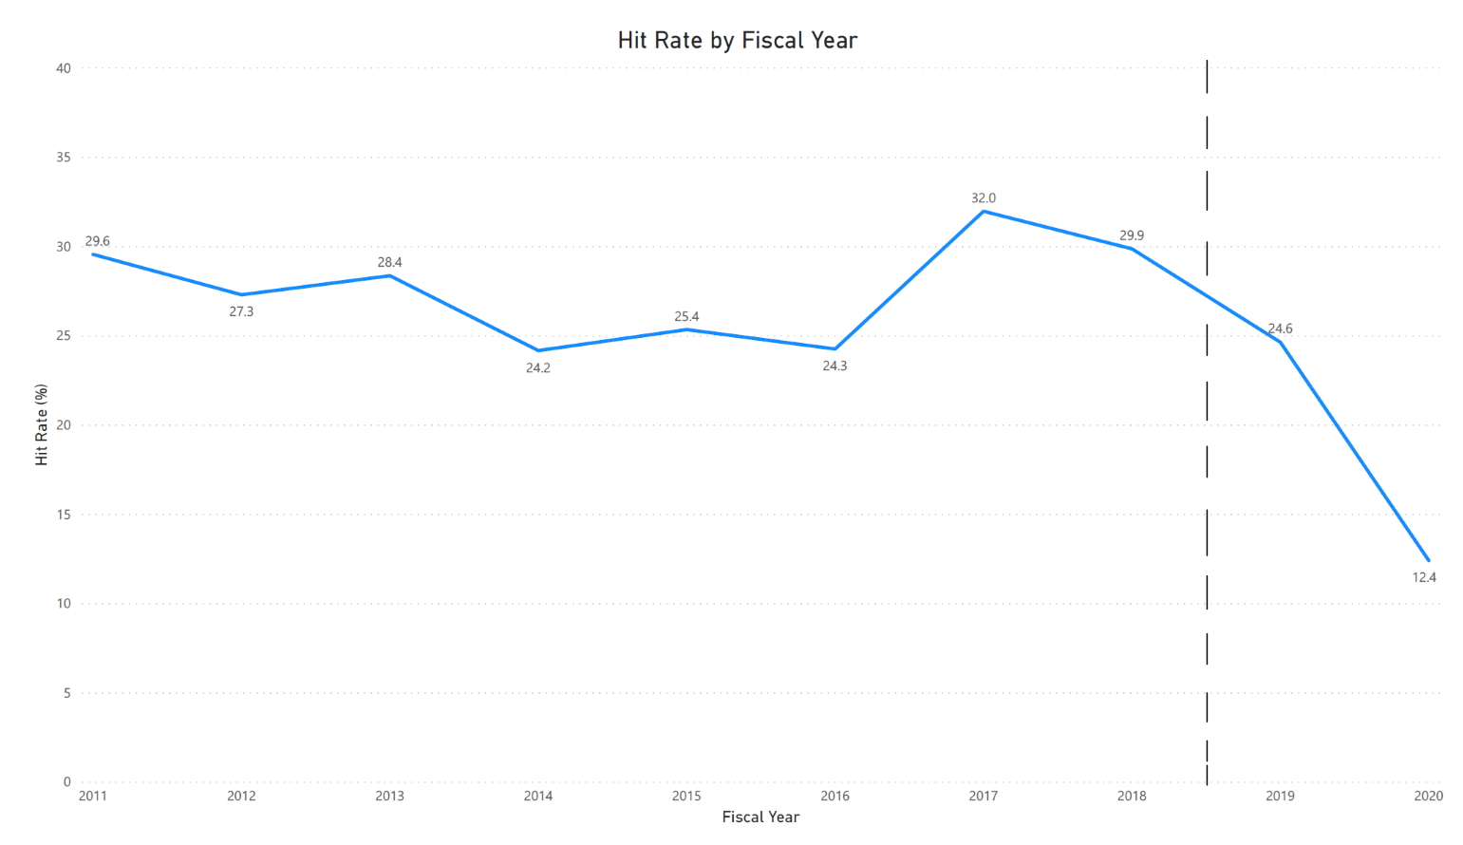
Hit Rate - Proposals Converted to New Awards by Fiscal Year
Average Annual Hit Rate: 25.80%
FY 2017 has the highest hit rate of 32%.
FY 2018 (the most recent full year of data), the hit rate was 29.9%
FY 2019 is 24.6% with one quarter of records absent.

Slide 34
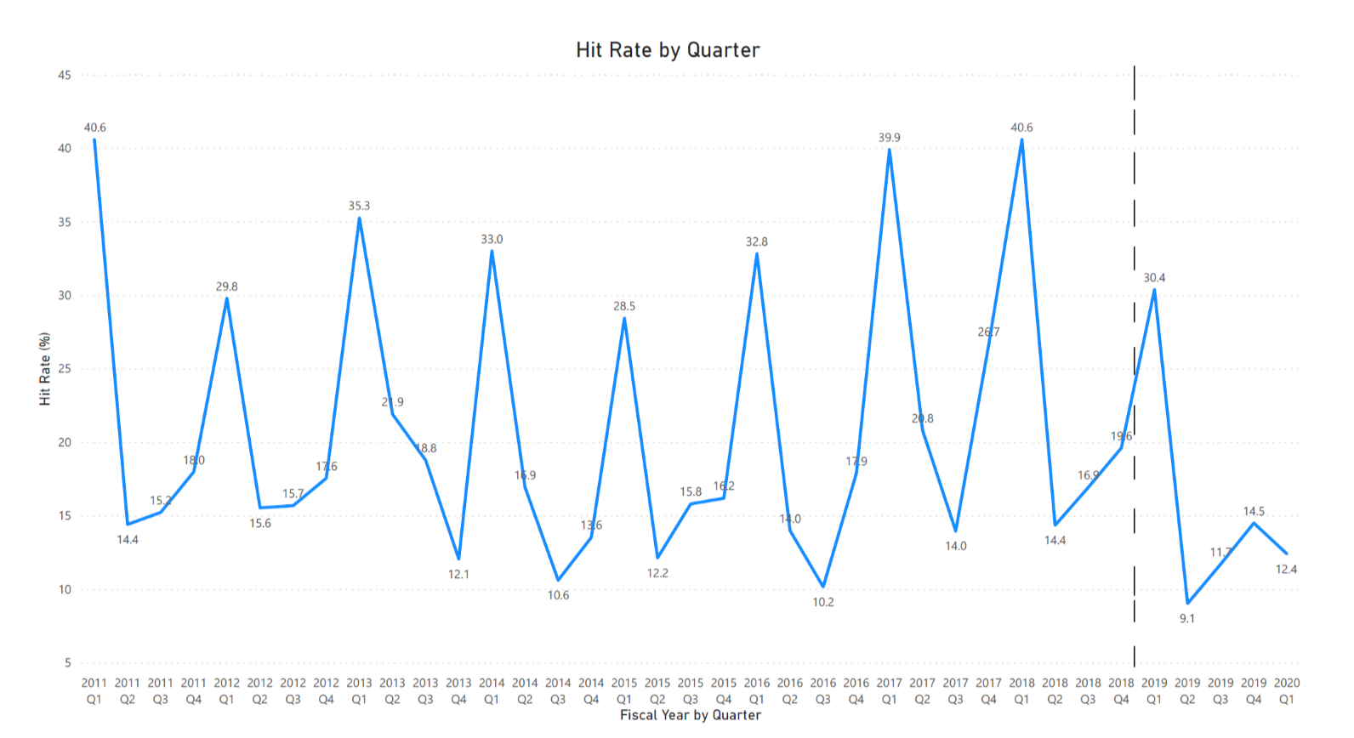
Hit Rate - Proposals Converted to New Awards by Quarter
Similar trend for Quarterly hit rate repeats over all the years.
Quarter 1 has the highest hit rate over the years.
Quarter 3 has the lowest hit rate over the years.
FY2018 Q1 has 40.6% hit rate and Q4 has 19.6% hit rate.

Slide 35
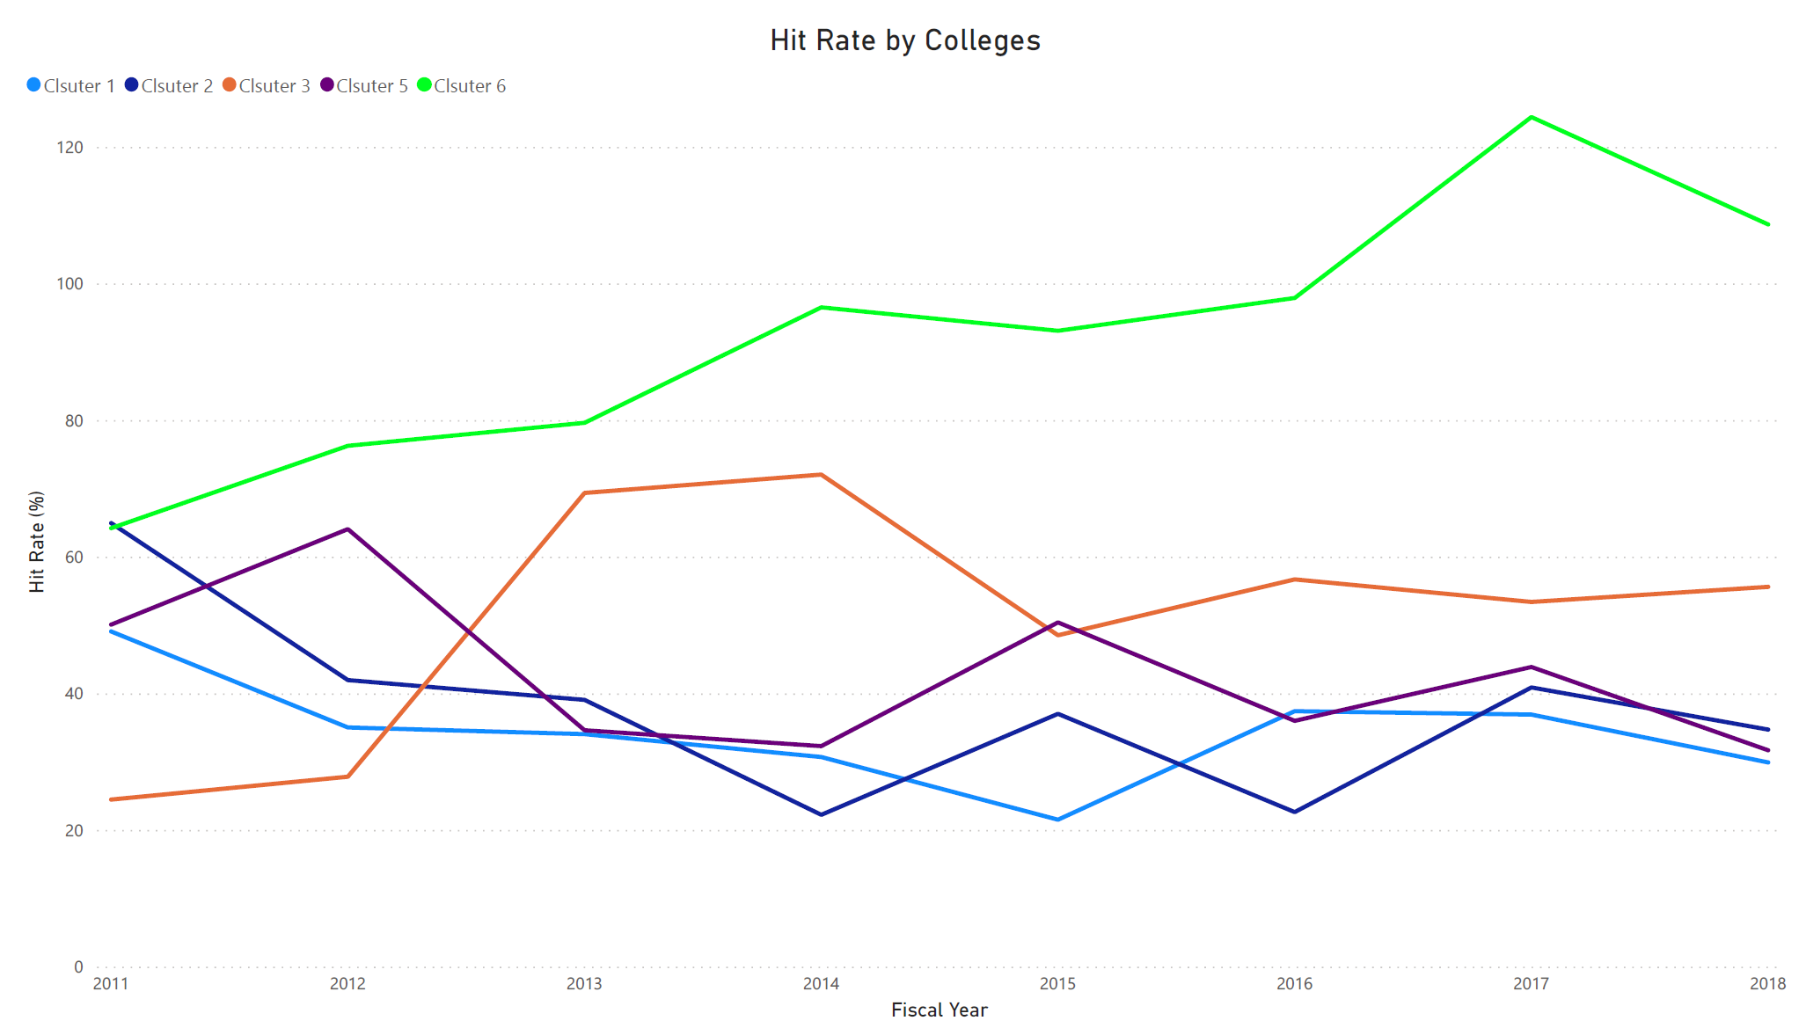
Cluster 1 (Average Hit Rate: 34.42%)
College of Engineering
College of Arts and Science
Cluster 2 (Average Hit Rate: 38.02%)
College of Computing & Informatics
School of Biomedical Engineering, Science and Health Systems
College of Nursing and Health Professions
Cluster 3 (Average Hit Rate: 51.08%)
LeBow College of Business
Goodwin College of Professional Studies
Westphal College of Media Arts and Design
Academy of Natural Sciences
School of Education
Other (NA college)
Cluster 4 (Omit)
College of Law
Close College of Entrepreneurship
Cluster 5 (Average Hit Rate: 42.97%)
College of Medicine
Cluster 6 (Average Hit Rate: 92.67%)
School of Public Health
Z other
Hit Rate by College (FYs 2011 – 2018)
Notes:
Cluster 6 has the highest average hit rate (92.67%) due to the most fluctuated awards receiving pattern. For example, there are a lot of awards receiving under Office of Research, but proposals were submitted by other departments or closure colleges.
Cluster 5 has moderate fluctuation in hit rate, which average hit rate is 42.97%.
Since cluster 3 is grouped by outlier colleges (Lebow and Westphal) due to the expansion of the department within the colleges and small but stable award amount, the trend of cluster 3 has the most fluctuation.
Cluster 1 and cluster 2 has the most stable hit rate, which average hit rate is 34.42% and 38.02%, respectively.

Slide 36
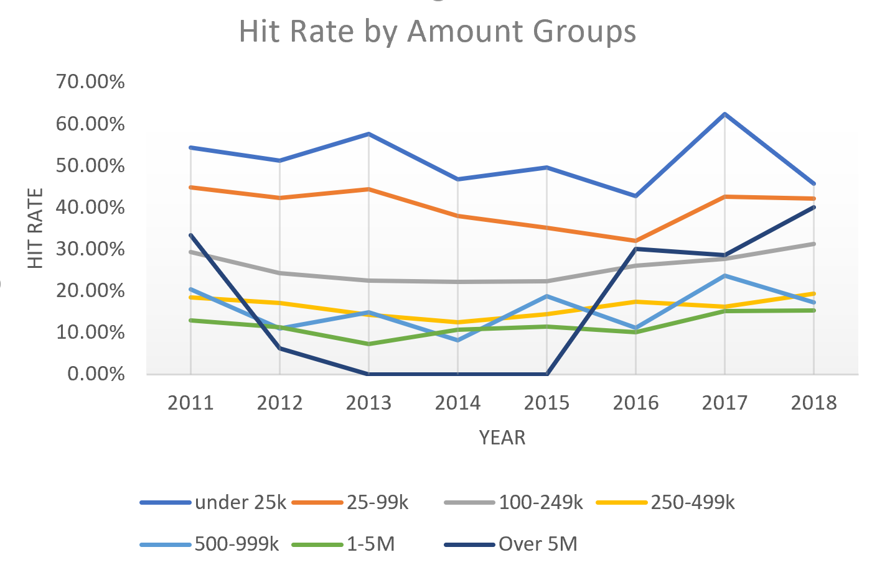
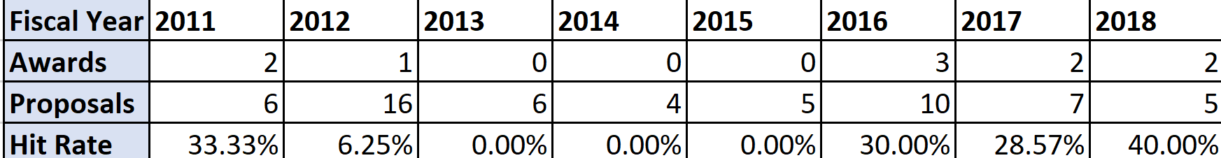
Hit Rate by Amount Group (FYs 2011 – 2018)
Under 25K
Average Hit Rate: 49.63% which is the highest of all the amount group
25-99K
Average Hit Rate: 37.57%
100-249K
Average Hit Rate: 24.47%
250-499K
Average Hit Rate: 14.81%
500-999K
Average Hit Rate: 14.78%
1-5M
Average Hit Rate: 10.98%
Over 5M
Average Hit Rate: 23.82% which has been increasing from 2015
Notes:
Average Hit Rate is 49.63% which is the highest of all the amount group for ‘under 25k’.
As the Amount group increases the hit rate decreases in all the Amount group except ‘Over 5M’ group.
The average Hitrate observed is 23.82% which has been increasing from 2015.

Slide 37
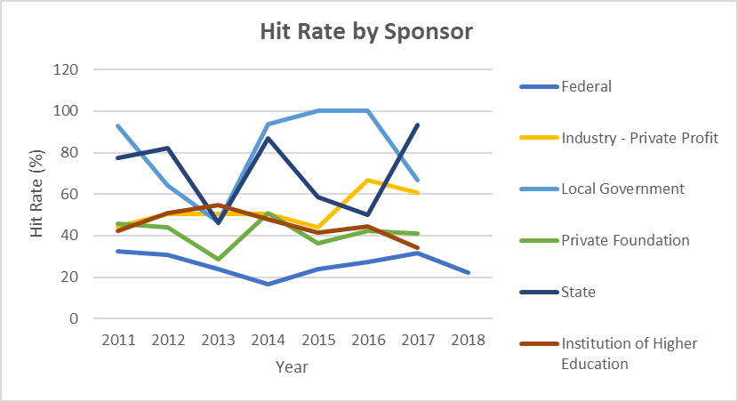
Hit Rate by Sponsor (FYs 2011-2018)
Federal has the largest proportion of awards, the average hit rate is 26% and has been decreasing in 2018.
For Local Government & State, average Hit rate is 83% & 73% which is higher than all other sponsor type.
Hit Rate for Private Foundation has an upward trend, whereas hit rate for Institution of Higher Education is decreasing over the years.

Slide 38
Forecasting

Slide 39
Forecasting - Approach
1
Data Preparation
Clusters by colleges
Proposal counts
Award counts
Award $$
Expenditure $$
2
Determine Proper Lag
Use case knowledge to determine lags for expenditure
Create ARIMA Forecast Models
Create a time series model to predict Awards $
Create a time series model to predict Expenditure $
4
Model Predictions
Use model to forecast future results
3

Slide 40
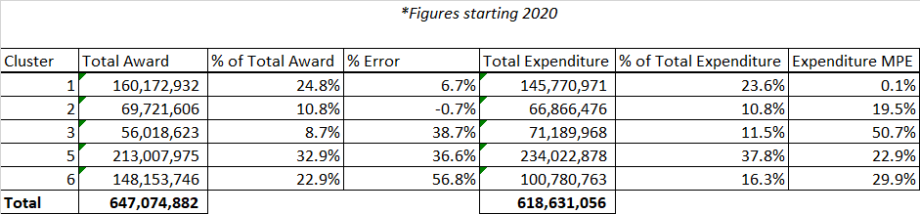
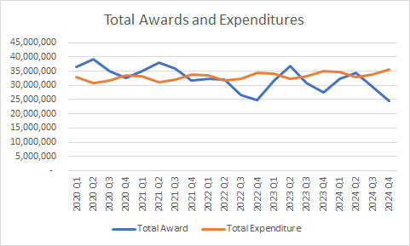
Forecasting – Summary Figures
Forecasting for Awards and Expenditures are done separately, having separate trends.

Slide 41
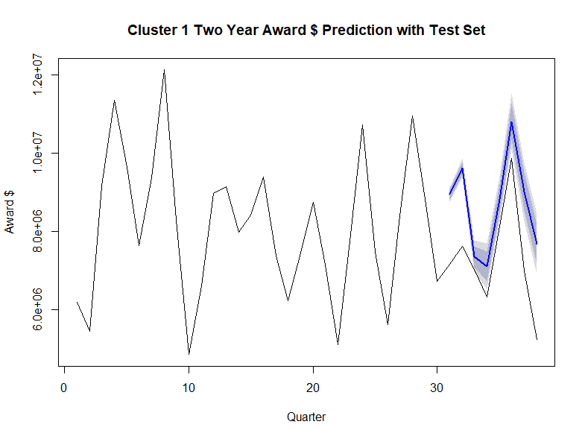
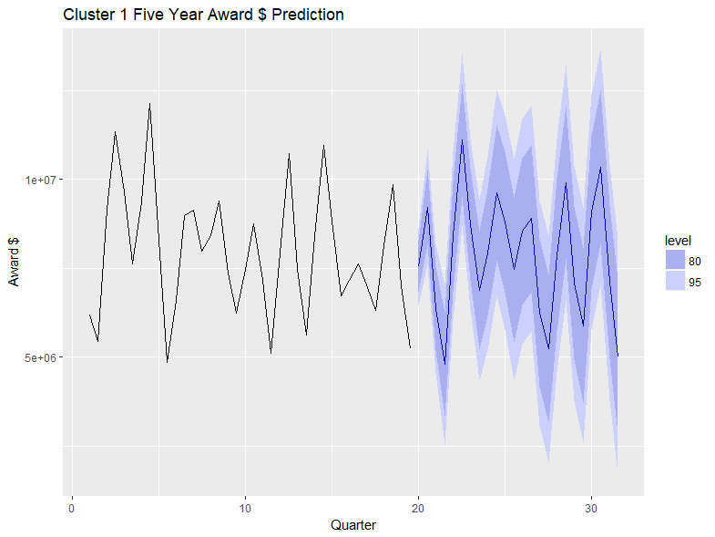
Cluster 1 Awards Forecast
As we know Cluster 1 is the most stable one and comprises of 24.8% of the awards amount from previous year and has the most stable growth rate.
Forecast of Cluster 1 for Awards comprises 22% of the total forecasted awards amount in upcoming 5 years.
It comprises of the 2nd highest forecasted Awards Amount.
The ARIMA(17,0,9) model seems to give a directionally correct forecast. And the actual observed values lie within the 95% confidence band.
An MPE of 6.67% implies that the model is about 93.3% accurate in predicting the next observations.

Slide 42
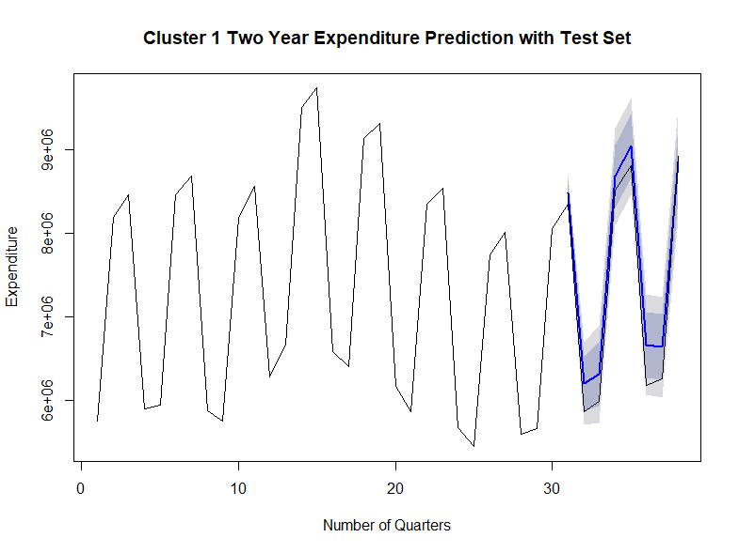
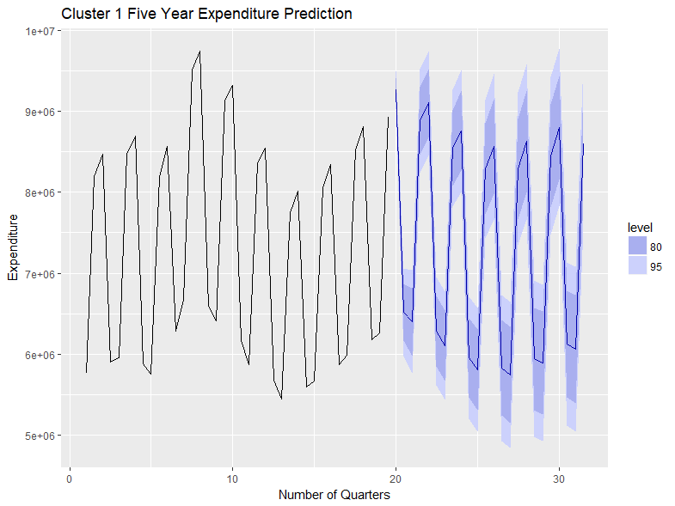
Cluster 1 Expenditure Forecast
The ARIMA(5,0,5) model seems to give a directionally correct forecast. The actual observed values lie within the 95% confidence band.
Around -.1% MPE implies the model is about 99.9% accurate in predicting the next observations.

Slide 43
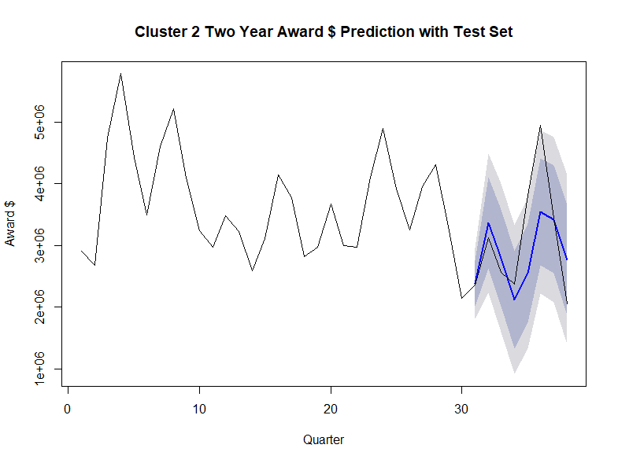
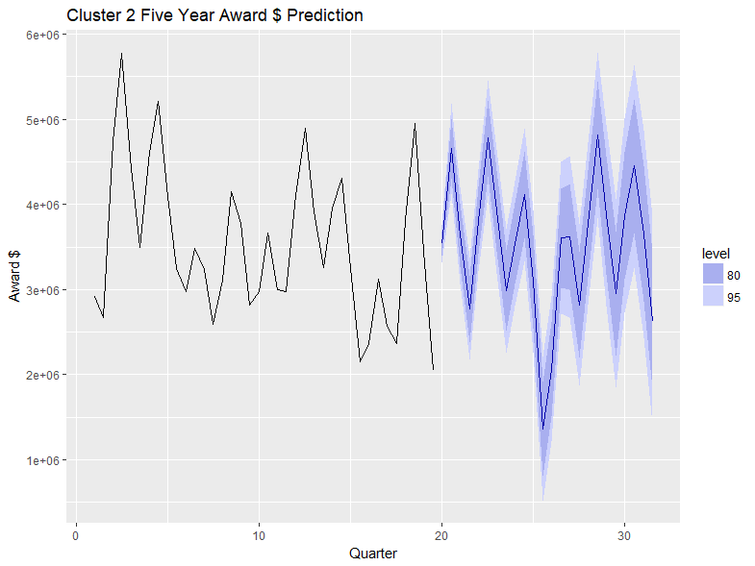
Cluster 2 Awards Forecast
Cluster 2 has an average growth for awards is around 3-7% compared as per previous years.
Forecast of Cluster 2 for Awards comprises 10.8% of the total forecasted awards amount in upcoming 5 years.
It comprises of the 4th highest forecasted Awards Amount.
The ARIMA(19,1,5) model seems to give a directionally correct forecast. The actual observed values lie within the 95% to 80% confidence band.
Around -0.7% MPE implies the model is about 99.3% accurate in predicting the next observations.

Slide 44
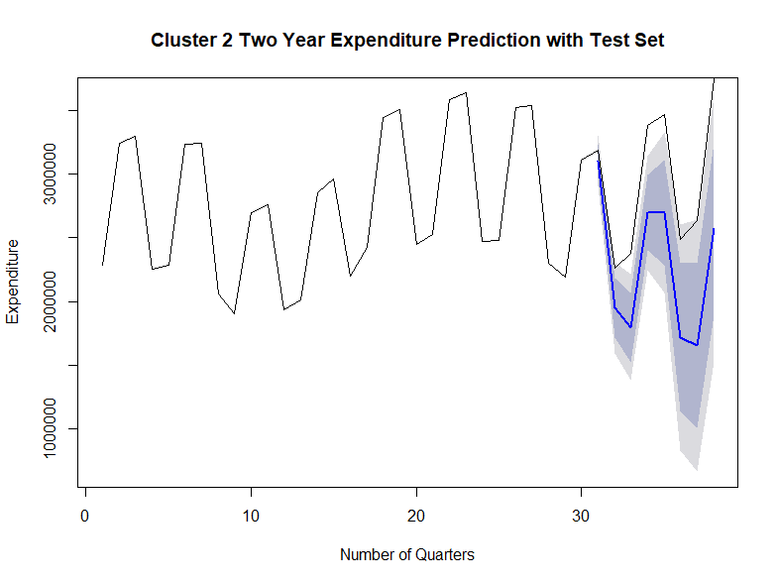
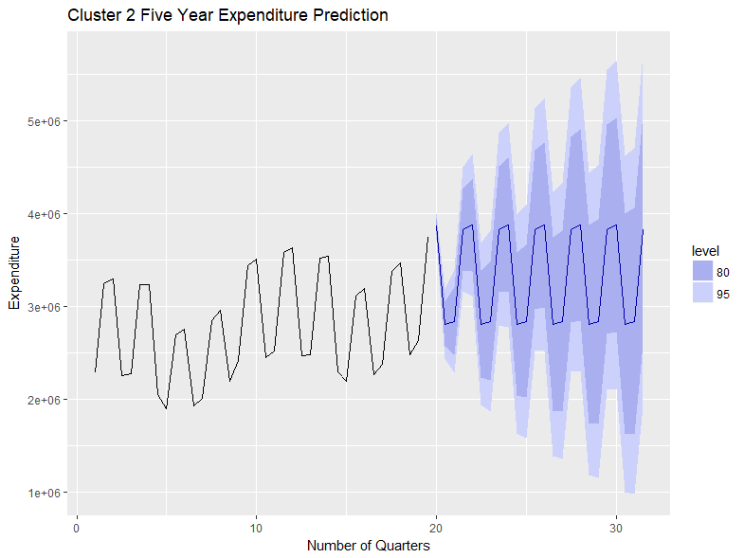
Cluster 2 Expenditure Forecast
The ARIMA(3,1,5) model seems to give a directionally correct forecast. The actual observed values lie within the 95% confidence band.
Around 19.5% MPE implies the model is about 80.5% accurate in predicting the next observations.

Slide 45
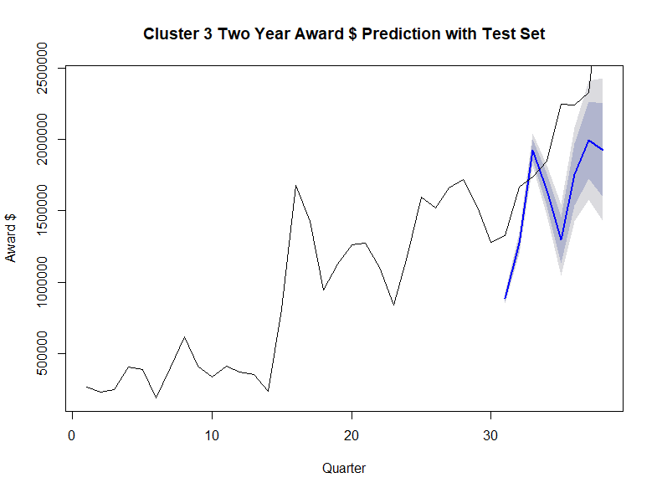
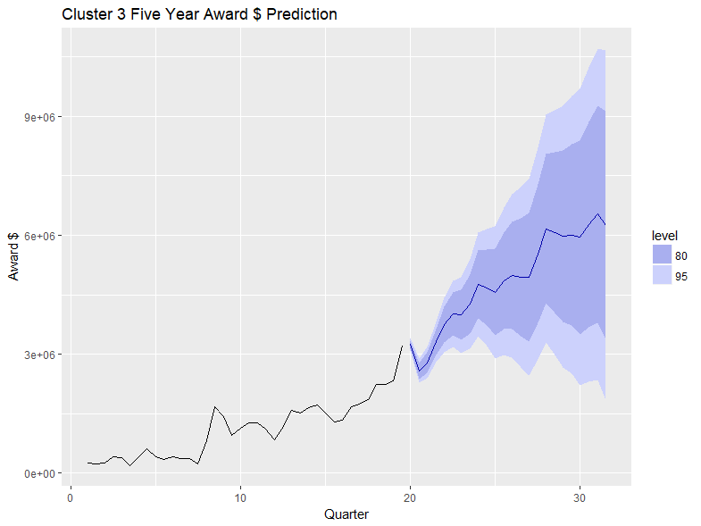
Cluster 3: Awards Forecast
Cluster 3 has the colleges which are most fluctuating in terms of their growth rate and contributes the least of all the clusters towards the total awards amount
Forecast of Cluster 3 for Awards comprises 8.7% of the total forecasted awards amount in the upcoming 5 years.
The ARIMA(19,1,5) model seems to give a directionally correct forecast but the actual observed values do not lie within the 95% to 80% confidence band due to high fluctuations in growth rate.
Around 38.7% MPE implies the model is about 61.3% accurate in predicting the next observations.

Slide 46
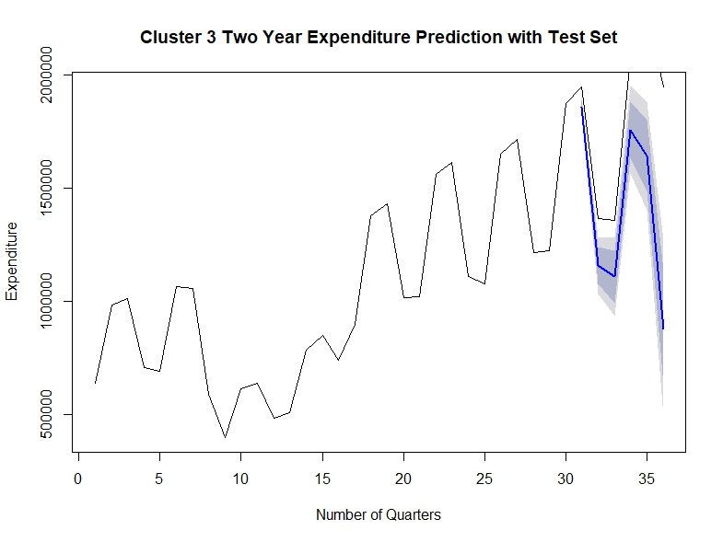

Cluster 3 Expenditure Forecast
The ARIMA(15,1,15) model seems to give a directionally correct forecast. And the actual observed values lie within the 95% confidence band.
Around 50.7% MPE implies the model is about 49.3% accurate in predicting the next observations.
This cluster has very difficult patterns to pick up, followed by significant growth. This makes it a very difficult group to forecast.

Slide 47


Cluster 5: Awards Forecast
Cluster 5 consists of “College of Medicine” which comprises 36.5% of the total Awards amount.
Forecast of Cluster 5 for Awards comprises 32.9% of the total forecasted awards amount in the upcoming 5 years.
The ARIMA(19,0,21) model seems to give a directionally correct forecast. The actual observed values lie within the 95% to 80% confidence band
An MPE of -36.6% implies the model is about 63.4% accurate in predicting the next observations.

Slide 48


Cluster 5 Expenditure Forecast
The ARIMA(3,2,5) model seems to give a directionally correct forecast. The actual observed values lie within the 95% confidence band.
Around 22.9% MPE implies the model is about 77.1% accurate in predicting the next observations.

Slide 49


Cluster 6: Awards Forecast
Forecast of Cluster 6 for Awards comprises of 22.9% of the total forecasted awards amount in upcoming 5 years..
The ARIMA(15,1,19) model seems to give a directionally correct forecast, but the actual and the forecasted value partially lies in the confidence band.
An MPE of 56.8% implies the model is about 43.2% accurate in predicting the next observations.

Slide 50


Cluster 6 Expenditure Forecast
The ARIMA(3,0,5) model seems to give a directionally correct forecast. The actual observed values lie within the 95% confidence band.
Around 29.9% MPE implies the model is about 70.1% accurate in predicting the next observations.
Cluster 6 is another group that is difficult to forecast, with large fluctuations and a recent spike.

Slide 51
Business Insights

Slide 52
Award Capacity - Introduction
Efficiency: amount per award
Sustainability: count of years for new award
Capability: count of award at the same year
Capacity
Dimension
Data
Overview
1049 investigators
Total Amount ($): 0.3K - 37M, average 1M
Amount per Award ($): 0.3K - 3M, average 0.2M
* By Investigator

Slide 53

Award Capacity – Efficiency
Calculating Efficiency
Calculation:
MAX(Expiration FY)
- MIN(Effective FY) + 1
÷
=

Slide 54
Award Capacity - Efficiency
Check Period Bias:
Before FY2017: 76%
Before FY2018: 80%

Slide 55
Award Capacity - Efficiency
Low Efficiency
Efficient
High Efficiency
How to improve?
Period 2-->3, 3-->4
High ROI
Efficient
Y Axis Calculation:
("Sum Amount per Award" %) / ("Count of Investigator" %)

Slide 56

Award Capacity - Sustainability
Fiscal Years of New Funds Table
Selected “New” award type
36% investigators has only one “Year of New Funds”
Investigator 20 has the highest “sum of New Awards”: 64

Slide 57
Award Capacity - Sustainability
Distribution of Research Period
≥ 5 years
Low Sustainability
High Sustainability
60%
13%
1 to 4 years
* Details in 1 “Years of New Funds”
Distribution of Research Period
2 to 4 years
≥ 5 years
* Details in 2 “Years of New Funds”

Slide 58
Award Capacity - Capability
X Axis
Max. project each investigator worked on in a given fiscal year during FY 2009 to FY 2019
Y Axis
Max. amount of money each investigator spent in a given fiscal year during FY 2009 to FY 2019
59/1049 Investigators as Outliers:
Top 4 Max Projects
Top 4 Max Amount
Max Projects = 0 (12 investigators)
Max Expenditure = 0 or negative (39 investigators)
($ Top 4: 13M,20M,16M, 21M)
(Top 4: 16,17,22,26)

Slide 59
Award Capacity - Capability
990 investigators without outliers:
 | Projects | Expenditure | Investigator Proportion
A | < 8 | >= $4M | 1.4%
B | >= 8 | >= $4M | 0.7%
C | < 8 | < $4M | 93.6%
D | >= 8 | < $4M | 4.3%
Area - A
Area - B
Area - C
Area - D

Slide 60
Award Capacity - Summary
Investigators | Total Amount (Avg. 1M) | Efficiency (Avg. 0.2M) | Sustainability | Capability
572 | Low | Low | Very Low | Very Low
73 | High | Medium | Very High | Very High
48 | High | Very High | Low | Low
295 | Medium | Medium | Medium | Medium
16 | Very High | Very High | Very High | Very High

Slide 61
Thank You

Slide 62
Appendix I – Missing Data
Cfda Number | 92.36
2 Digit CFDA | 92.32
Level2 | 81.28
Prime Sponsor Name | 77.21
Prime Sponsor Type | 77.21
Prime Sponsor Code | 77.21
Opportunity | 63.17
Award Type | 61.8
Award Type Code | 61.8
Level1 | 48.72
Original Spon Hierachy | 31.79
Deadline Date | 7.51
ID number | 0.07
Prime Sponsor Hier | 86.51
Prime Sponsor Name | 80.1
Prime Sponsor Type | 80.1
Prime Sponsor Code | 80.1
SponsorHier | 62.93
Original Spon Hierachy\r\r\n | 51.85
Award Execution Date | 3.41
Transaction Type | 2.12
Award Effective Date | 0.96
Proposal Number | 0.96
Sponsor Award Number | 0.5
College, School, Etc. | 0.47
Sponsor Type Group | 0.37
Banner | 0.35
Unit Number | 0.26
Frbgrnt Grnt Code Related | 98.44
Spriden Last Name2 | 94.03
PT Agency | 82.63
Frragpt Federal Fund Percent | 82.63
Frragpt Agcy Pidm | 82.63
ID | 81.95
Frvcfda Cfda Code | 34.95
Frvcfda Title | 34.95
2 digit cfda | 34.95
Frbgrnt Basi Code Ic | 11.19
Frbgrnt Indr Code Rate | 11.19
Frbgrnt Sponsor Id | 2.18
Frbgrnt Code | 0.66
Frbgrnt Sub Category | 0.18
Frbgrnt Category | 0.02
Frbgrnt Grant Type | 0.01
Proposals
Awards
Expenditure

Slide 63


Appendix II – Data Cleaning
% of Missing Values for Expenditure

Slide 64


Potential Hypothesis I
Appendix III – Potential Hypothesis
Trend analysis in Awards amount verses Expenditure amount based on the sponsor type category
Our expenditure is decreasing over the years which is our preliminary question, but the Awards through Federal grants and other sources are increasing over the time. Let’s observe for last 5 years of records the expenditure under federal grant has dropped from $80 million to $28 million in 2018 and the awards funding has increased from $65 million to $85 million.
Notes:
The above Plots shows us how our expenditure is decreasing over the years which is our preliminary question, but the Awards through Federal grants and other sources are increasing over the time. The trend line in Blue shows us the difference in expenditure and Awards for Federal Sponsor type
Let’s observe for last 5 years of records the expenditure under federal grant has dropped from $80 million to $28 million in 2018 and the awards funding has increased from $65 million to $85 million.

Slide 65


Potential Hypothesis I
Let’s look at the private and foreign funding and expenditure in the below graphs, where the expenditure has dropped significantly from $17 million to almost $3 million and at the same time the funding from private and foreign sources has an upward trend.
Notes:
Let’s look at the private and foreign funding and expenditure in the below graphs, where the expenditure has dropped significantly from $17 million to almost $3 million and at the same time the funding from private and foreign sources has an upward trend.
But in case of expenditures for foreign category, the expenditures are going up from 2014 to 2017 and then it's decreasing. the funding tough is increasing over the period but there is a significant drop in funding in foreign category in 2018.

Slide 66


Potential Hypothesis II
Trend analysis in No. of Proposals Converted to Awards in Each Amount Group
Since group 5 and group 6 are the one with high amounts of proposals that makes sense but there is an upward trend in both the groups in last few years
This can be one of the reasons why awards amount is increasing

Slide 67
Potential Hypothesis III
Trend analysis in No. of Count and total amount in each quarterly year for Proposal/Awards/Expenditure
We can see large no of proposals are made in Quarter 2 & Quarter 3
Whereas for Awards the awards count increases in Quarter 1 and Quarter 4
But in terms of Expenditure, we can see a clear pattern that the count of records against each award has also increased along with the expenditure amount
Questions:
Why expenditures in quarter 3 are higher than other quarters.
Why over all expenditures are low.

Slide 68


Potential Hypothesis III

Slide 69

Potential Hypothesis III

Slide 70
Hit Rate By College
Fiscal Year | under 25k | 25-99k | 100-249k | 250-499k | 500-999k | 1-5M | Over 5M
2011 | 54.29% | 44.77% | 29.26% | 18.44% | 20.34% | 12.93% | 33.33%
2012 | 51.15% | 42.29% | 24.27% | 17.16% | 10.94% | 11.21% | 6.25%
2013 | 57.66% | 44.34% | 22.49% | 14.23% | 14.89% | 7.22% | 0.00%
2014 | 46.72% | 38.02% | 22.16% | 12.55% | 8.16% | 10.74% | 0.00%
2015 | 49.63% | 35.19% | 22.34% | 14.34% | 18.70% | 11.48% | 0.00%
2016 | 42.73% | 31.92% | 25.96% | 17.33% | 11.11% | 10.14% | 30.00%
2017 | 62.40% | 42.60% | 27.64% | 16.16% | 23.58% | 15.15% | 28.57%
2018 | 45.69% | 42.11% | 31.28% | 19.37% | 17.24% | 15.29% | 40.00%
2019 | 52.69% | 38.24% | 23.12% | 10.56% | 17.31% | 11.69% | 100.00%
2020 | 33.33% | 16.22% | 16.13% | 8.00% | 5.56% | 4.00% | 0.00%
Average | 49.63% | 37.57% | 24.47% | 14.81% | 14.78% | 10.98% | 23.82%

Slide 71
Hit Rate By Amount Group
Fiscal Year | under 25k | 25-99k | 100-249k | 250-499k | 500-999k | 1-5M | Over 5M
2011 | 54.29% | 44.77% | 29.26% | 18.44% | 20.34% | 12.93% | 33.33%
2012 | 51.15% | 42.29% | 24.27% | 17.16% | 10.94% | 11.21% | 6.25%
2013 | 57.66% | 44.34% | 22.49% | 14.23% | 14.89% | 7.22% | 0.00%
2014 | 46.72% | 38.02% | 22.16% | 12.55% | 8.16% | 10.74% | 0.00%
2015 | 49.63% | 35.19% | 22.34% | 14.34% | 18.70% | 11.48% | 0.00%
2016 | 42.73% | 31.92% | 25.96% | 17.33% | 11.11% | 10.14% | 30.00%
2017 | 62.40% | 42.60% | 27.64% | 16.16% | 23.58% | 15.15% | 28.57%
2018 | 45.69% | 42.11% | 31.28% | 19.37% | 17.24% | 15.29% | 40.00%
2019 | 52.69% | 38.24% | 23.12% | 10.56% | 17.31% | 11.69% | 100.00%
2020 | 33.33% | 16.22% | 16.13% | 8.00% | 5.56% | 4.00% | 0.00%
Average | 49.63% | 37.57% | 24.47% | 14.81% | 14.78% | 10.98% | 23.82%

Slide 72
Hit Rate for Sponsor Type
Fiscal Year | Fedral Hit Rate (%) | Private Non-Profit_Hit Rate (%) | Foreign Private Profit_Hit Rate (%) | Industry - Private Profit_Hit Rate (%) | Local Government_Hit Rate (%) | Institution of Higher Education_Hit Rate (%) | Foreign Institution of Higher Education_Hit Rate (%) | Private Foundation_Hit Rate (%) | State_Hit Rate (%) | Foreign Private Non-Profit_Hit Rate (%) | Foreign Federal Government_Hit Rate (%) | Foreign Foundation_Hit Rate (%)
2011 | 32.65940902 | 44.44444444 | 100 | 81.52174 | 100 | 60.49383 | 66.66667 | 38.75 | 90 | 100 | 100 | NA
2012 | 30.60498221 | 45.86466165 | 71.428571 | 44.66019 | 92.85714 | 42.34234 | 100 | 45.52846 | 77.27273 | 25 | 100 | NA
2013 | 24.0704501 | 31.31313131 | 80 | 50.3876 | 64.28571 | 50.86207 | NA | 44.0678 | 82.35294 | NA | 100 | NA
2014 | 16.4410058 | 42.85714286 | NA | 50.47619 | 46.66667 | 54.78261 | 33.33333 | 28.44828 | 46.15385 | 16.66667 | NA | NA
2015 | 23.70936902 | 42.42424242 | 50 | 50.51546 | 93.75 | 47.85714 | NA | 50.84746 | 86.66667 | NA | 100 | NA
2016 | 27.24077329 | 41.42857143 | 100 | 44.18605 | 100 | 41.44737 | NA | 36.15385 | 58.62069 | 50 | 100 | NA
2017 | 31.71641791 | 56.30252101 | 66.666667 | 66.66667 | 100 | 44.375 | 80 | 42.37288 | 50 | 100 | 100 | 100
2018 | 22.15447154 | 52.25225225 | NA | 60.60606 | 66.66667 | 34.33735 | 100 | 41.12903 | 93.33333 | 33.33333 | NA | 100
2019 | 15.78947368 | 37.37373737 | 33.333333 | 54 | 50 | 16.54135 | 33.33333 | 44.44444 | 56.52174 | 25 | 100 | NA
2020 | 4.651162791 | 5.882352941 | NA | 27.77778 | 100 | 17.85714 | NA | 30.76923 | 33.33333 | NA | NA | NA

Slide 73
Cluster 1 - Expenditure Forecast

Slide 74
Cluster 2 - Expenditure Forecast

Slide 75
Cluster 3 - Expenditure Forecast

Slide 76
Cluster 5 - Expenditure Forecast

Slide 77
Cluster 6 - Expenditure Forecast

Slide 78

Awards Forecast – Cluster 6
Graph shows Cluster 6
Proposal Forecast times hit rate

Slide 79
Drexel University Milestones
2010 – John Fry becomes President of Drexel
2011 – Academy of Natural Sciences becomes a part of Drexel
2011 – Papadakis Integrated Sciences building opens
2012 – AJ Drexel Autism Institute is founded
2012 – Close School of Entrepreneurship is founded
2013 – College of Computing and Informatics is founded
2014 – Dana and David Dornsife Center for Neighborhood Partnerships opens
2014 – Law school receives $50 million donation from Thomas R Kline and starts to expand
2016 – Drexel enters partnership with Brandywine Trust to develop Schuylkill Yards

Slide 80
Award Capacity - Sustainability

Slide 81

Award Capacity - Cluster
($2.5e+05)
($1.4e+05)
(1.3)
(1.5)
($3.8e+06)
($2.3e+05)
(8.1)
(7.7)
($3.3e+06)
($1.0e+06)
(2.0)
(2.2)
($1.5e+06)
($2.2e+05)
(4.1)
(4.0)
($1.8e+07)
($1.2e+06)
(7.4)
(8.6)

Slide 82

Forecast Models
Cluster 1
Examine the quarterly award $ data
Each cluster behaved differently, we had to run tests on each cluster separately.
This section will walk through the process with cluster 1.
It is possible to create a purely time series forecast.
Notes:
train is all data up to 2017
Arima model fitted to each specific dataset
After proposal prediction, hit rate to determine awards per cluster
Cluster 1 and 6 are a good example at the difficulties of forecasting depending on the school, some schools (cluster 1) are easy to forecast, while cluster 6 has a lot of random variance, making it more difficult
See appendix IV for more clustering info

Slide 83

Forecast Models
Step 1 - Transform the data
To create a bi-yearly moving average
ARIMA requires to
create a robust and accurate model
Not stationary
take the difference of the data to pass it through a time series model.
Notes:
After train/test we use the model to predict 5 year forecast
See appendix IV for more clustering info

Slide 84

Forecast Models
Step 2
Examine the ACF and PACF lags
PACF graph
significant lag at period (quarter) 2
Notes:
Next step is to use a simple regression for awards to explain/predict award $
After determining individual lag, models explain between 10% and 30% of variation in award $
This method clearly needs some updating, we need to look into more distinct lags or figuring out a time series fit for award $
There was a lot of variation in all the award $ clusters, making it difficult to forecast
See appendix IV for more clustering info

Slide 85

Forecast Models
Step 3
make the model
Auto-fit
minimizes the AIC
not necessarily have the best parameters
After much testing and validating,
a seemingly good model with ARIMA (17,0,9).
2 years of data is the test set
Notes:
Next step is to use a simple regression for awards to explain/predict award $
After determining individual lag, models explain between 10% and 30% of variation in award $
This method clearly needs some updating, we need to look into more distinct lags or figuring out a time series fit for award $
There was a lot of variation in all the award $ clusters, making it difficult to forecast
See appendix IV for more clustering info

Slide 86

Forecast Models
Step 4
Check the residuals
Residuals
no defined patterns
relatively normally distributed
according to the line graph
Similarly, our model does not have
any significant ACF or PACF lags,
meaning that the ARIMA model successfully
picked up all the lags and that our data is stationary.
Notes:
Next step is to use a simple regression for awards to explain/predict award $
After determining individual lag, models explain between 10% and 30% of variation in award $
This method clearly needs some updating, we need to look into more distinct lags or figuring out a time series fit for award $
There was a lot of variation in all the award $ clusters, making it difficult to forecast
See appendix IV for more clustering info

Slide 87

Forecast Models
Step 5
Test the model – Award $
Forecast 5 years out
bi-yearly
80 and 95% confidence intervals for our data
Award $ to drop back down from its recent peak
confidence intervals -> have a good pattern
Notes:
Next step is to use a simple regression for awards to explain/predict award $
After determining individual lag, models explain between 10% and 30% of variation in award $
This method clearly needs some updating, we need to look into more distinct lags or figuring out a time series fit for award $
There was a lot of variation in all the award $ clusters, making it difficult to forecast
See appendix IV for more clustering info

Slide 88
Forecast Models
Step 6
Test the model - Expenditure
Assumed the % of expenditure in each quarter replicates that of the award $.
Take the average % of yearly award $ for each quarter and apply that to expenditures.
Notes:
Next step is to use a simple regression for awards to explain/predict award $
After determining individual lag, models explain between 10% and 30% of variation in award $
This method clearly needs some updating, we need to look into more distinct lags or figuring out a time series fit for award $
There was a lot of variation in all the award $ clusters, making it difficult to forecast
See appendix IV for more clustering info

